Slide 1
Simple Family Photos
Family Photo Albums for You and Your Grandma
Charlie Regan, Tim Clark, David Cohen

Slide 2
Vision
Easy-to-use photo storage and presentation
Can be accessed on any computer via Web interface
Simplifies the process of viewing and sharing photos between family members by avoiding the clutter of sites like Facebook

Slide 3
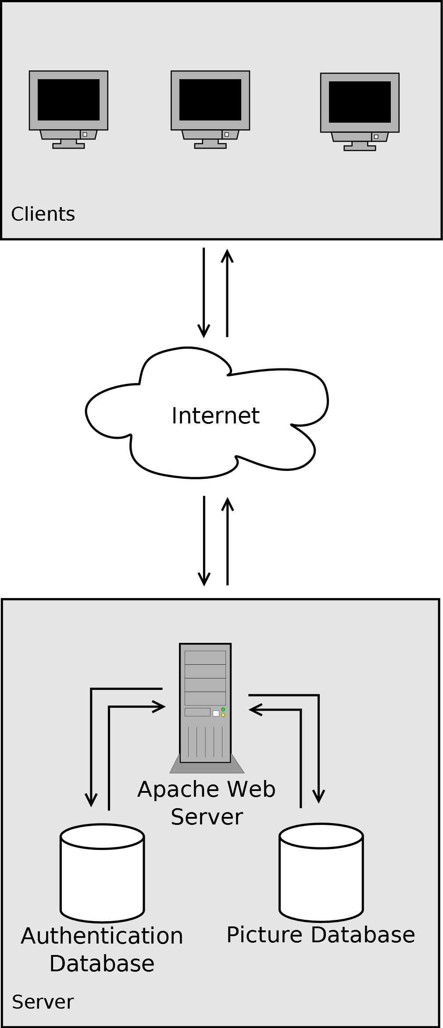
Architecture
Database storage for photos, metadata, and login information
Dynamic web interface utilizing JavaScript and PHP backend
Options to organize and view photos by event, date, or person
Quickly download local copies of photos in a simple click.

Slide 4
Difficulties
Designing an easy-to-use interface
communication and testing with intended clients (non-CSE majors!)
Avoiding complexity from feature creep
Image tagging and organization
efficiency
Authentication process
“family” vs. individual
Database Organization
image storage, file verification, database scaling

